Slide 2
Great scientists

Slide 3
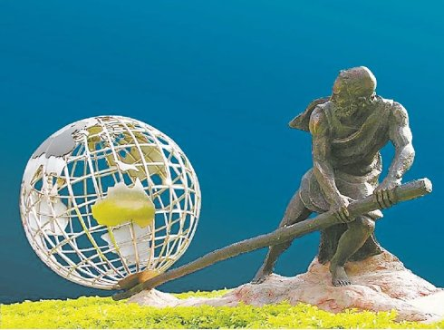
1. Archimedes
Archimedes (287 BC – c. 212 BC) was an Ancient Greek mathematician, physicist, engineer, inventor and astronomer. He found that objects in water are lifted by a force, and explained the principle of the lever.

Slide 4
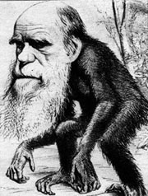
2. Charles Darwin
Charles Darwin (1809 - 1882) was a British scientist. He wrote the book “the Origins of Species”, explaining how creatures develop as the environment changes.

Slide 5
3. Thomas Newcomen
Thomas Newcomen (1663 - 1729) was an English inventor who created the first practical steam engine for pumping water, the Newcomen steam engine.

Slide 6

4. Mendel
Mendel (1822 - 1884), was the founder of the modern science of genetics, who used peas to show how physical characteristics are passed from parents to their children.

Slide 7
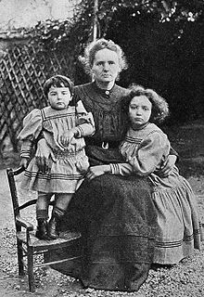
5. Marie Curie
Marie Curie (1867 - 1934), was a Polish and naturalized-French physicist and chemist who conducted pioneering research on radioactivity. She was the first woman to win a Nobel Prize, the first person and only woman to win twice, the only person to win twice in multiple sciences.

Slide 8
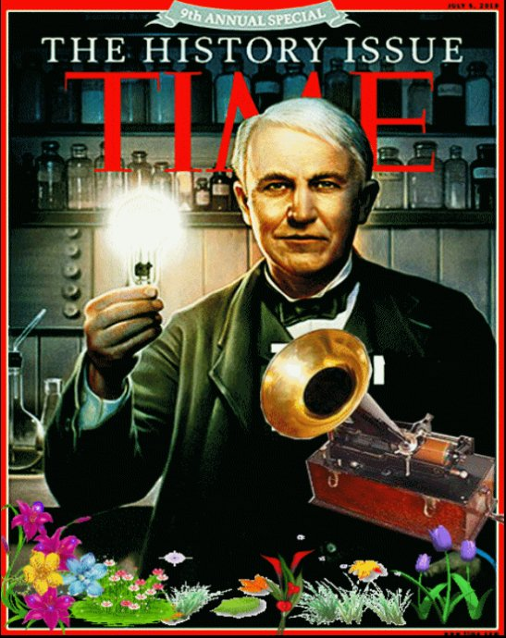
6. Thomas Edison
Thomas Edison (1847- 1931) was an American inventor and businessman who developed many devices that greatly influenced life around the world, including the phonograph and the long-lasting, practical electric light bulb.

Slide 9
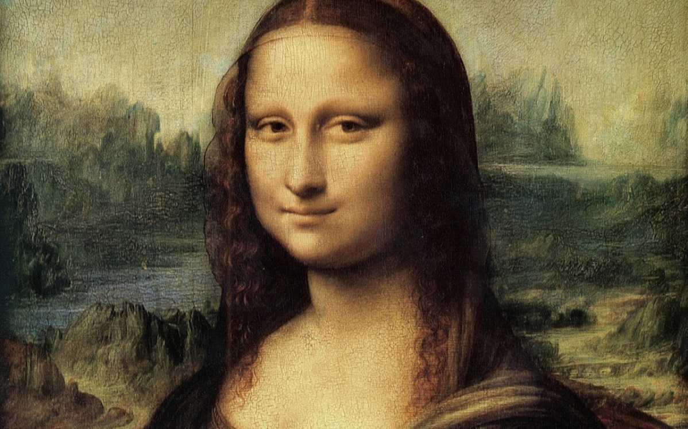
7. Leonardo da Vinci
Leonardo da Vinci (1452 - 1519) was an Italian who was versatile in various areas such as painting, architecture, science, invention, music etc. He is often seen as the great exemplar of the Renaissance Man.

Slide 10

8. Sir Humphry Davy
Sir Humphry Davy (1778 - 1892) was a British chemist and inventor. He is best remembered today for his discovery of several metals and elements, one of which is sodium.

Slide 11
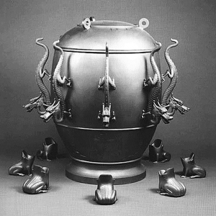
9. Zhang Heng
Zhang Heng (78 - 139) was a Chinese scientist who invented the first device to indicate in the direction of the earthquake.

Slide 12
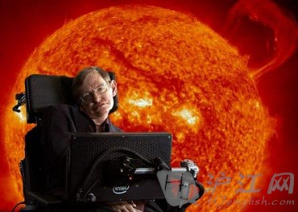
10. Stephen Hawking
Stephen Hawking (1942 - ) is an English theoretical physicist, cosmologist, the author of “the Brief History of Time”. He put forward a theory about black holes, which explains the beginning of new galaxies.

Slide 13
Stages for a scientific research
draw a conclusion
think of a method
collect results
make a question
find a problem
analyse the result
find supporting evidence

Slide 14
John snow defeats “king cholera”
draw a conclusion
think of a method
collect results
make a question
find a problem
analyse the result
find supporting evidence
7
3
4
2
1
5
6

